Slide 1
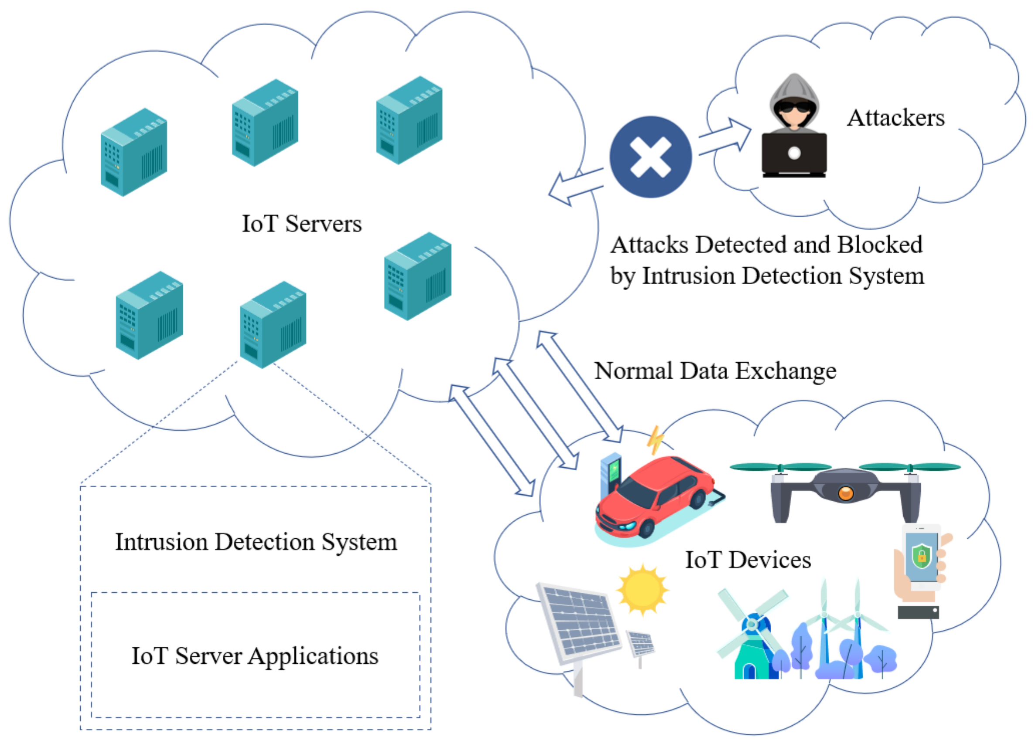
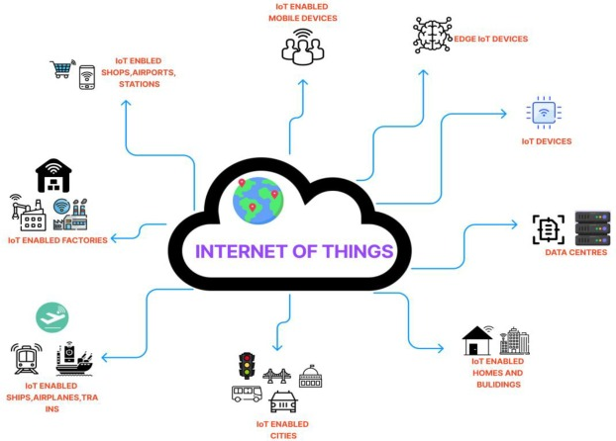
Automated intrusion detection and alert system with Iot integrated and AI.

Slide 2



Team Details
Team Name: A21
Naresh Bista (Team Leader)
Harsha Surya
College: SPEC
Stream : AI&DS
Year of graduation: 2025
21BK1A7239
College: SPEC
Stream: AI&DS
Year of graduation:2025
21BK1A7223
Gollapally Venu
College: SPEC
Stream: AI&DS
Year of graduation:2025
21BK1A7220
2

Slide 3
Theme
Making security smarter and more efficient
The theme of this project is all about making security smarter and more efficient by combining IoT and machine learning. It’s designed to keep people and places safe by using connected devices like sensors and cameras to monitor activities and detect threats in real-time. With the help of machine learning, the system learns to identify patterns and predict potential dangers, making it smarter over time.

Slide 4
Abstract
This project focuses on designing an automated intrusion detection and alert system for IoT environments using machine learning. As IoT devices become increasingly prevalent, security concerns arise due to their vulnerability to unauthorized access. This system leverages IoT sensors to monitor real-time activities and uses machine learning algorithms to distinguish between normal and suspicious behaviors.
When an anomaly is detected, the system generates immediate alerts to notify users, enabling quick responses to potential threats. The integration of IoT and machine learning ensures scalability, accuracy, and adaptability to new attack patterns. This solution enhances security in smart homes, offices, and industrial IoT settings by proactively mitigating risks.

Slide 5
Objective
Real-time Threat Detection: Use IoT sensors and devices to monitor and identify unauthorized
access or suspicious activities in real-time.
Machine Learning-Based Insights: Employ machine learning algorithms to analyze patterns,
detect anomalies, and improve detection accuracy over time by learning from past events.
Comprehensive Alerts: Generate instant alerts via multiple channels (e.g., SMS, email, or
mobile app notifications) to inform relevant personnel or authorities about potential threats.
Seamless IoT Integration: Connect various IoT devices (cameras, motion detectors, door
locks, etc.) for a unified and efficient security solution.
Scalability and Flexibility: Design the system to accommodate different environments, from homes to enterprises, ensuring scalability as security needs evolve

Slide 6
Literature Survey
Machine Learning for Intrusion Detection Explains the role of machine learning in enhancing IDS, focusing on supervised and unsupervised techniques for detecting
anomalies and improving threat identification.
IoT Integration in Security Systems Discusses the application of IoT devices in security, their benefits in real-time monitoring, and the vulnerabilities they introduce, such as
network and data security concerns.
Efficient IoT Data Processing with Edge and Fog Computing Examines methods for processing the large volume of real-time data generated by IoT devices, emphasizing edge and fog computing to reduce latency and ensure faster responses.
Challenges in IoT-Based IDS Highlights the key issues in IoT-based intrusion detection systems, including scalability, heterogeneity of data, adversarial threats, and energy constraints of IoT devices.

Slide 7
Existing System and Drawback
Basic IoT Security Systems: Smart home security systems like Ring, Nest, or ADT integrate IoT devices such as doorbells, cameras, and motion detectors. They provide real-time notifications but are often limited in their ability to analyze complex patterns or predict threats.
Multi-Sensor IoT Networks: Many intrusion detection systems use sensor fusion techniques where data from multiple sensors (motion, sound, vibration, and video) are combined to make more accurate intrusion predictions. This reduces false positives and enhances the reliability of alerts.
ADT Smart Home Security: ADT offers a comprehensive smart home security system, which integrates IoT sensors with machine learning for intrusion detection and sends automated alerts through mobile apps or text messages.

Slide 8
Drawbacks
Limited Scope of Signature-Based Detection:
Fails to detect new or unknown attacks (zero-day vulnerabilities).
Requires constant updates to signature databases.
High False Positives in Anomaly-Based Detection:
Often flags benign activities as threats, leading to alert fatigue.
Inefficient when training data lacks quality or diversity.
Scalability Issues in IoT Systems:
IoT devices generate massive amounts of data, overwhelming centralized systems.
Limited computational resources of IoT devices restrict advanced processing.
Lack of Adaptive Learning:
Traditional systems do not learn or evolve with new data,reducing their long-term effectiveness.

Slide 9
Proposed solution
1.Vice-Activated Commands
Allow users to interact with the system using voice commands (e.g., “Activate alarm,” “Check live feed,” or “Disable alerts”), making it more user-friendly.
2. AI-Powered Behavior Analysis
Implement AI models that analyze behavior patterns. For example, instead of just detecting motion, the system could assess whether the movement aligns with typical human behavior or something unusual (e.g., someone lurking near a door).
3. Multi-Modal Threat Detection
Combine data from multiple sources (e.g., video, audio, and vibration sensors) to improve accuracy. For instance, unusual sounds, combined with detected motion, can confirm an intrusion more reliably.

Slide 10
4. Dynamic Alert Customization
Allow users to set customized alerts based on specific scenarios. For
example, a loud alarm might sound for intrusions at night, while silent
notifications could be sent during the day.
5. Self-Healing IoT Network
Enable the system to detect and recover from device failures automatically.
If one sensor or device goes offline, others should compensate to ensure no
gaps in monitoring.
6.Edge Computing for Faster Responses
Instead of sending all data to the cloud, edge computing can process data
locally on IoT devices. This reduces latency, ensures faster detection of
threats, and provides functionality even during internet outages.

Slide 11
SYSTEM ARCHITECTURE
AMSS
AI Assistant
(Text-to-speech)
Machine Learning
System Monitoring
(Real Time interface)
Deploy
Notification & Alert System (Alert User via UI, Audio, Email,) etc.
Detect Malware Files
IoT Devices and
Network Monitoring
(IoT Sensors, Cameras, Logs, etc.)
Anti-Malware
software

Slide 12
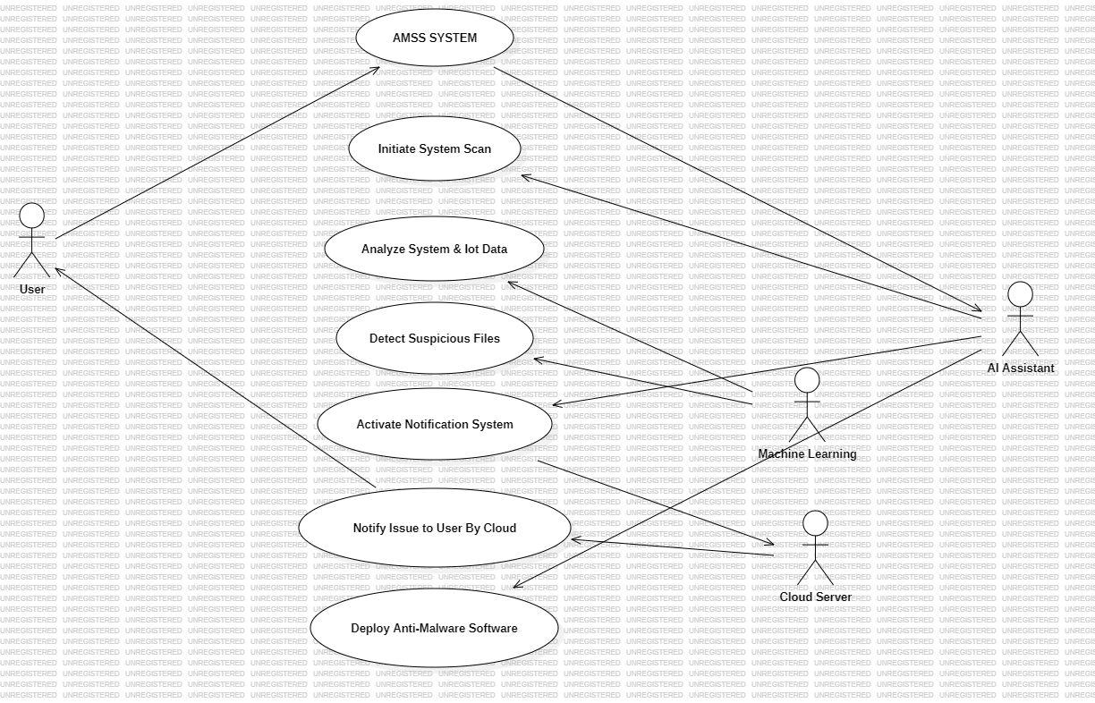
UseCase Diagram

Slide 13
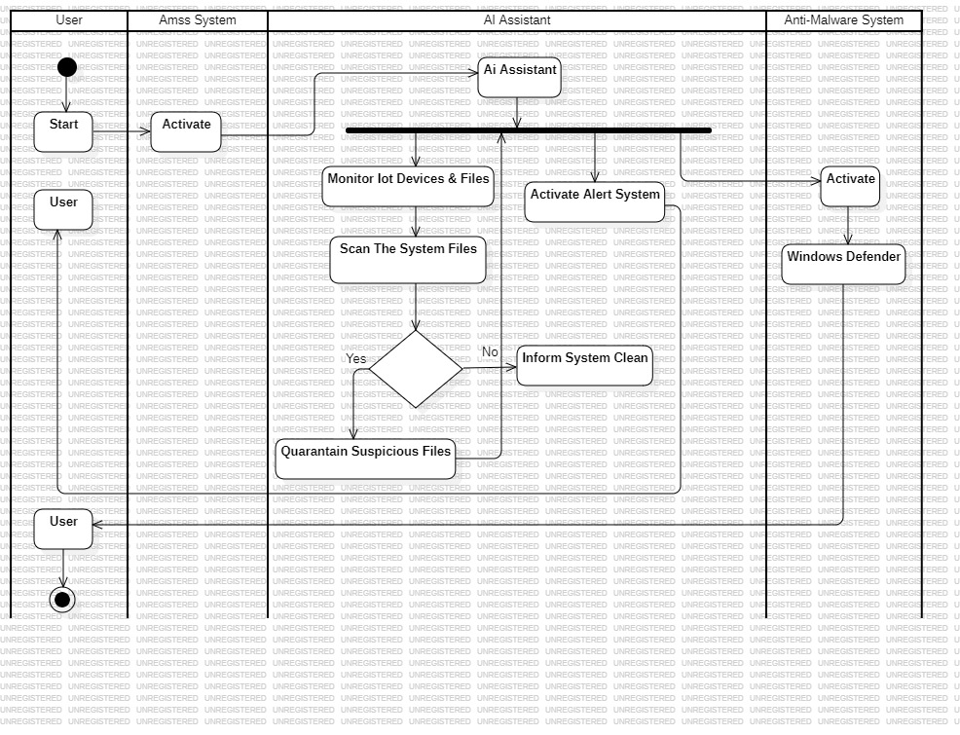
ACTIVITY DIAGRAM
End

Slide 14
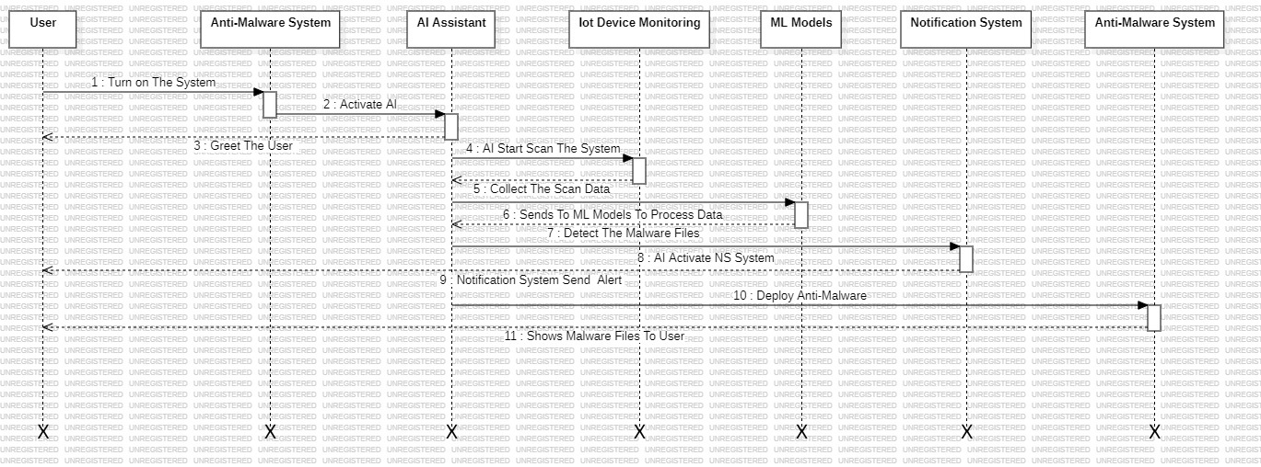
Sequence Diagram

Slide 15
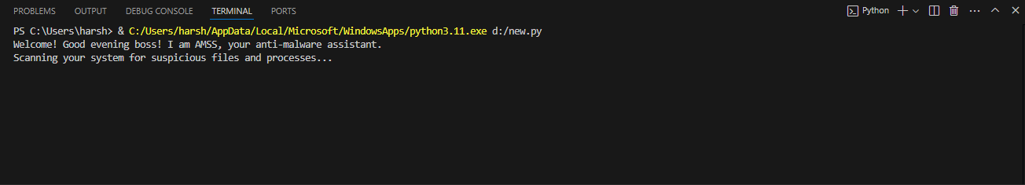
RESULTS

Slide 16
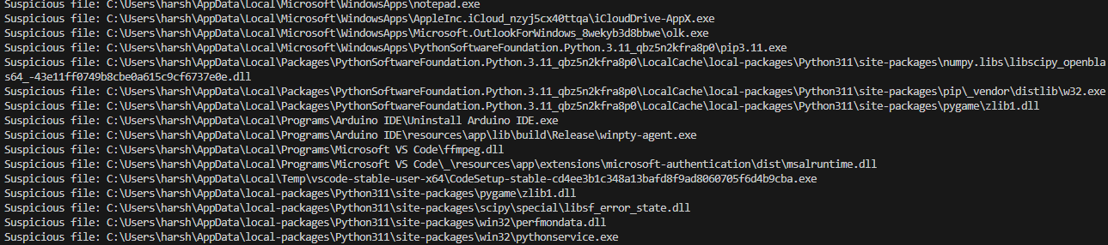

Slide 17
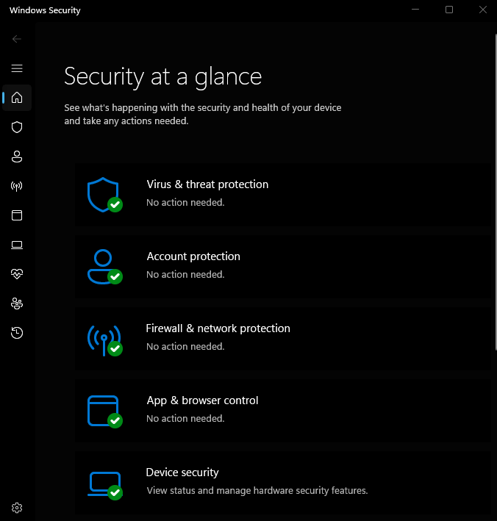

Slide 18
HARDWARE & SOFTWARE REQUIREMENTS
Hardware Requirements
IoT Devices:
Sensors: Motion detectors, infrared sensors, temperature sensors, etc.
Processing Units:
Microcontrollers: Arduino, ESP32, or Raspberry Pi for edge processing.
Networking Equipment:
Routers and switches for seamless communication between IoT devices.
Wireless modules: Wi-Fi, Zigbee, or LoRa for IoT device connectivity.
Storage:
Local storage: Solid-state drives (SSD) or SD cards for edge devices.
Central storage: Cloud-based or on-premise storage with at least 1 TB capacity.
Display and User Interface Devices:
Monitors or mobile devices for viewing alerts and system status.

Slide 19
Software Requirements
Software Requirements
Operating Systems:
IoT Devices: Lightweight OS like Windows, Mac os or Ubuntu Core.
Servers: Linux-based distributions like Ubuntu Server or CentOS.
Programming Languages:
Python: For developing machine learning models and IoT device scripts.
C/C++: For low-level programming on microcontrollers.
3.Communication Protocols:
MQTT, CoAP, or HTTP for data exchange between IoT devices and servers.
4.Alert and Notification Services:
Integration with services like Twilio for SMS notifications or Firebase for push notifications.
5.Security Tools:
Encryption libraries (e.g., OpenSSL) for securing communication.
Firewall and IDS software for network security.

Slide 20
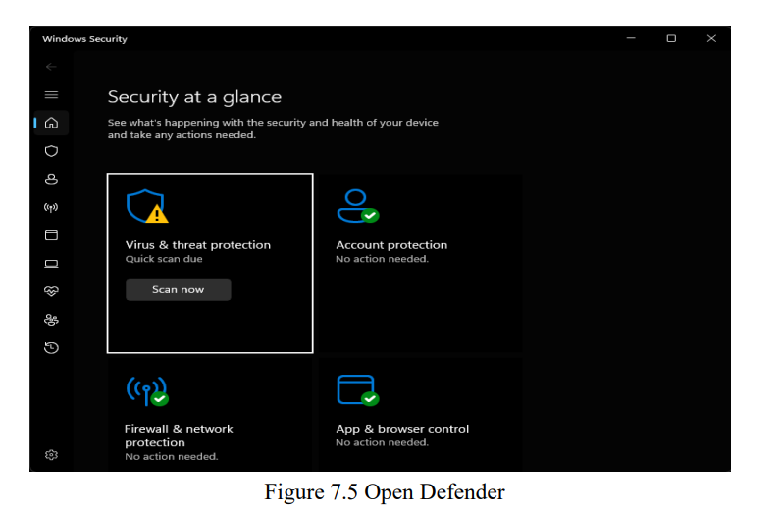
Final Output

Slide 21
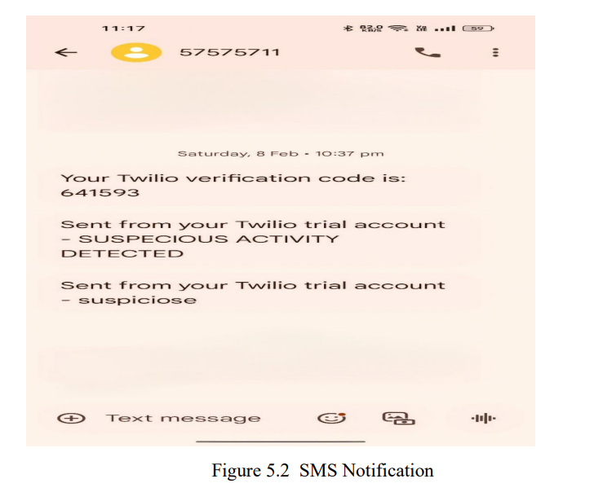

Slide 22
Conclusion
An automated intrusion detection and alert system integrated with IoT and machine learning (ML) provides a powerful solution for securing networks and devices. The system uses IoT sensors and devices for real-time monitoring, detecting anomalies such as unusual network traffic or abnormal device behavior, which may signal a security threat.
Machine learning enhances this system by learning from historical data to recognize normal behavior patterns. It can detect new, evolving threats by identifying deviations from the established norm, reducing false positives and increasing detection accuracy over time. This ability to learn and adapt makes the system increasingly effective as it gathers more data.
The system automatically alerts security personnel or administrators upon detecting an intrusion, ensuring rapid response and minimizing damage. Its scalability allows for easy integration of additional IoT devices, making it adaptable to growing networks. Moreover, machine learning algorithms improve over time, making the system smarter and more resilient against emerging threats.
This solution is not only effective but also cost-efficient, as it reduces the need for continuous manual monitoring. Overall, an automated intrusion detection system with IoT and ML provides a dynamic, proactive, and scalable approach to cybersecurity, ensuring robust protection against unauthorized access and malicious activities.

Slide 23
Reference
https://doi.org/10.3390/electronics13183601
https://www.mdpi.com/2079-9292/13/18/3601?utm_source=chatgpt.com

Slide 24

Queries?

Slide 25


